Slide 1
WORK PERFORMED AT KVK FARM DURING 2019-2020(AS ON 20/01/2020)
Sl.No | WORK / ACTIVITIES PERFORMED | MONTHLY ACTIVITIES PERFORMED DURING THE YEAR 2019-20 |  |  |  |  |  |  |  |  |  |  |  | AREA (In Ha) | Amount utilised (In Lakh) | Amount received (2019-20) (In Lakhs) | Amount utilised (2019-20) (In Lakhs)
 |  | April | May | June | July | Aug | Sept | Oct | Nov | Dec | Jan | Feb | Mar
1 | Cultivation of Paddy for field Demonstration |  |  |  |  |  |  |  |  |  |  |  |  | 0.7 | 0.1825 | 0.4875 | 0.4875
2 | Cultivatiomn of Maize for field demonstration on FAW & Maize Var-RCM-75 & 76 |  |  |  |  |  |  |  |  |  |  |  |  | 0.25 | 0.066
3 | Cultivation of Groundnut Var: ICGV-91114 |  |  |  |  |  |  |  |  |  |  |  |  | 0.25 | 0.0665
4 | Intercultural Operation of existing Crops |  |  |  |  |  |  |  |  |  |  |  |  | 1.0 | 0.09
5 | Cultivation of Winter Vegetables (Cabbage, Brocolli, Cauliflower and Field Pea ) for Demonstration |  |  |  |  |  |  |  |  |  |  |  |  | 0.25 | 0.0825
20 | Monthly utilization of fund (in Lakhs) during 2019-20 | 0.035 | 0.024 | 0.027 | 0.133 | 0.0245 | 0.03 | 0.0815 | 0.0465 | 0.0725 | 0.0135 | - | - | 2.45Ha | 0.4875 | 0.4875 | 0.4875

Slide 2
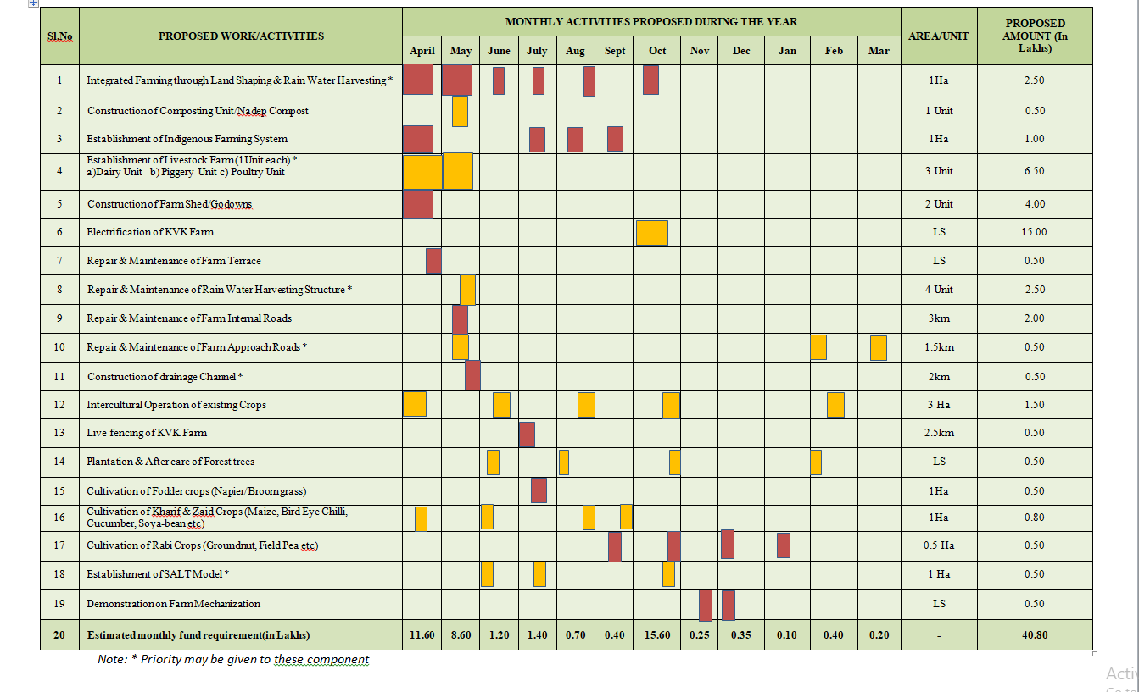
ACTION PLAN / PROPOSED WORK AT KVK FARM DURING 2020-2021

